Slide 1
SPOMS - Basics
(SS4I)

Slide 2
Topics
Main Objectives
Development Process
Product Quality
Software Delivery

Slide 3
Main Objectives
Of the System

Slide 4
Main Objectives
SPOMS
Order Management
Warehouse Management
Conduct Survey

Slide 5
Main Objectives
Order Management:
Create and remove Orders from customers.
Manage User information
Persist not yet requested products in cart
Warehouse Management:
Manage AGVs and their behaviour
Complete Tasks
Manage product catalog
Conduct Survey:
Conduct surveys for a given audience
Allow Customer to answer
Create reports for a given survey

Slide 6
Development Process
And Planning

Slide 7
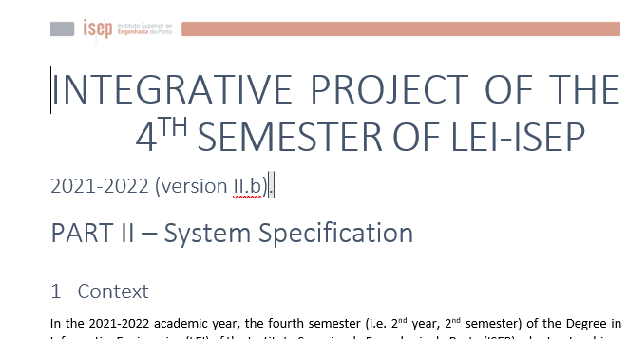
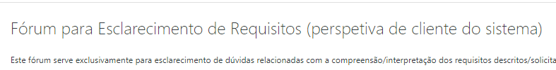
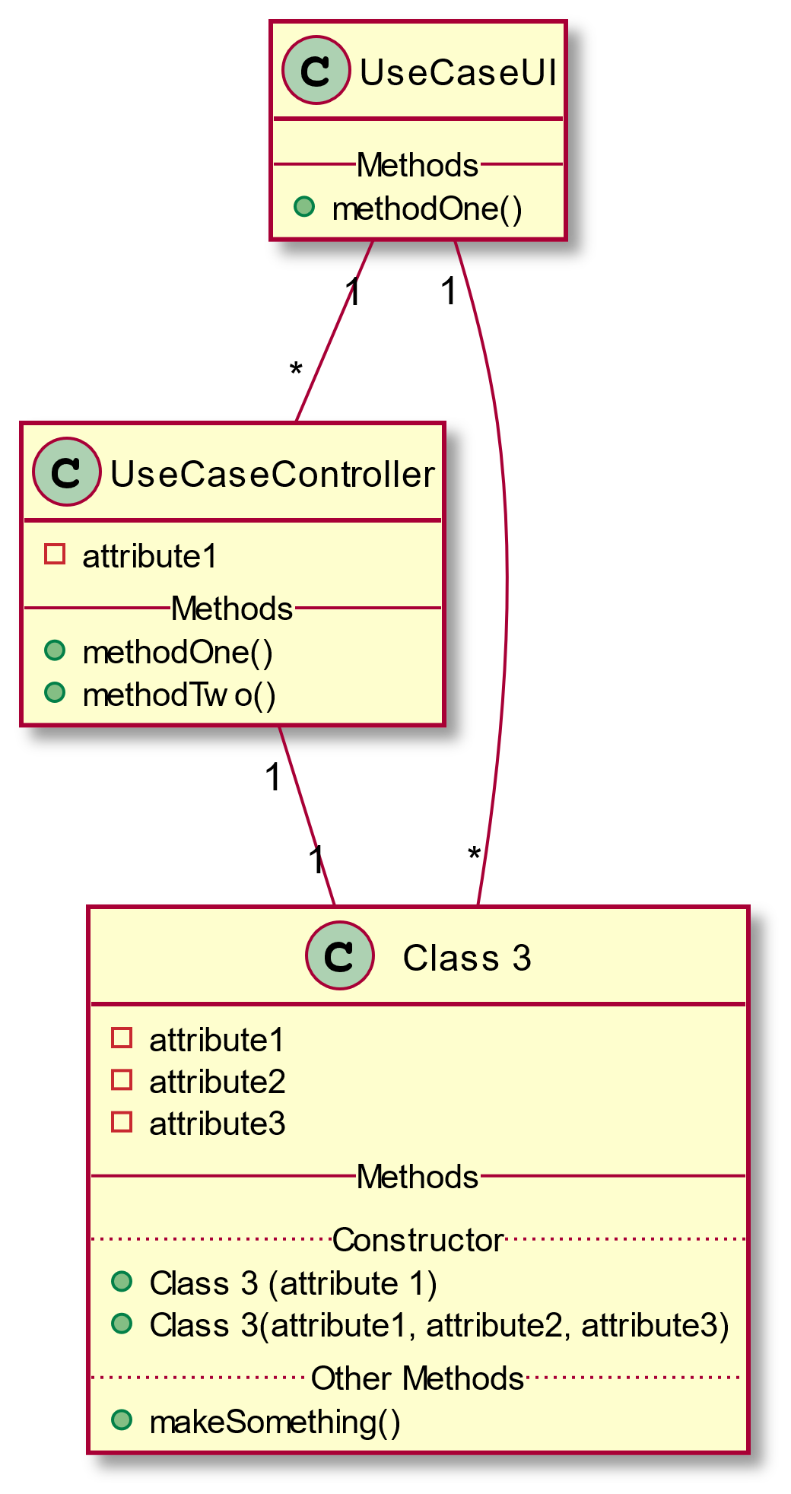
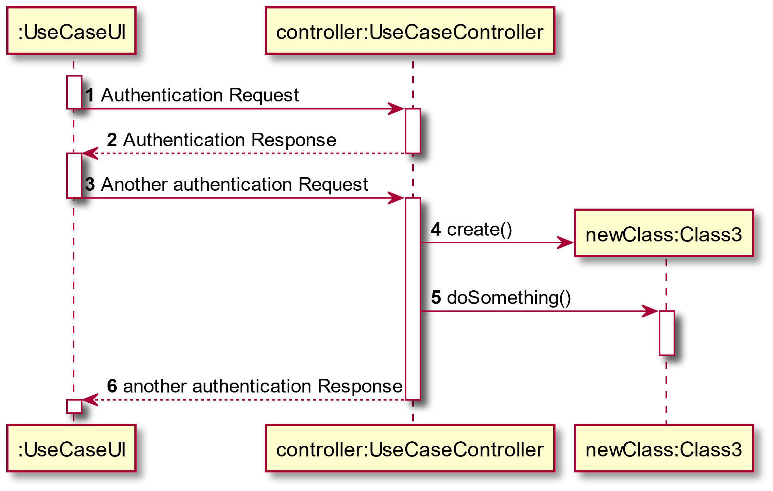
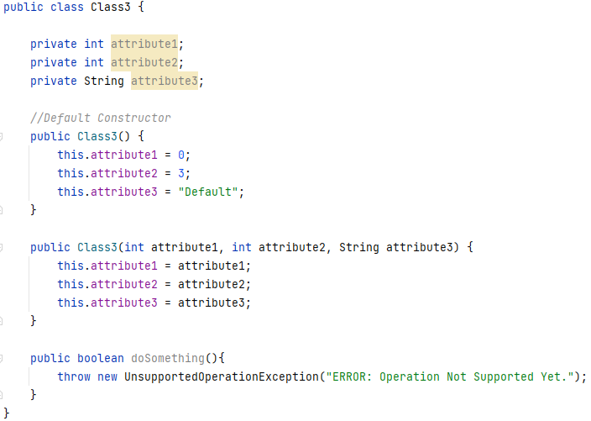
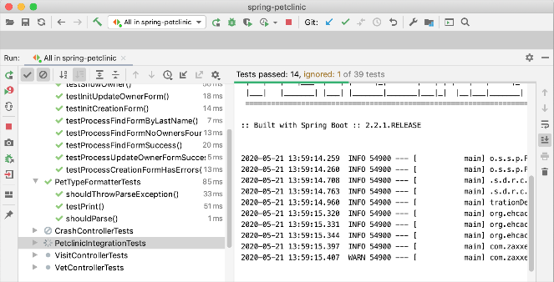
Development Process
Analysis
Design
Implementation

Slide 8
Main Objectives
Analysis:
Record requirements
System Sequence Diagram
Domain Model excerpt
Design:
Class Diagram
Sequence Diagram
Implementation:
Implementation
Testing
Review

Slide 9
Teamwork Methodology
Scrum Methodology:
Conflict Resolution:
Used when requirements change frequently
Self-governing teams
Constant Increment
Short Sprints
Discuss within the team
The task assignee chooses to either implement or not the opinions
Always thinking about what the client wants

Slide 10
Work Done
ID | Atividade | Responsável | Real | Estado
0004 | Prepare project structure | 1201217 – Marco Ramos | Begin:11-04-2022 End: 18-04-2022 | ✓
1001 | Create Product | 1190827 – Luís Araújo | Begin:13-04-2022 End: 01-05-2022 | ✓
1002 | See Product Catalog | 1190827 – Luís Araújo | Begin: 27-04-2022 End: 01-05-2022 | ✓
1003 | Create Client | 1201216 – Lucas Guimarães | Begin: 24-04-2022 End: 01-05-2022 | ✓
1004 | Create Order | 1201217 – Marco Ramos | Begin: 29-04-2022 End: 01-05-2022 | ✓
1005 | Define Category | 1201228 – Ana Rita Silva | Begin:29-04-2022 End: 01-05-2022 | ✓
1900 | Bootstrap | 1201180 – Guilherme Sencadas | Begin: 13-04-2022 End: 01-05-2022 | ✓
2001 | Import JSON file | 1201228 – Ana Rita Silva | Begin:29-04-2022 End: 01-05-2022 | ✓
2002 | Configure AGV | 1201216 – Lucas Guimarães | Begin: 26-04-2022 End: 01-05-2022 | ✓
9001 | Presentation | 1201180 – Guilherme Sencadas | Begin: 11-04-2022 End: 13-04-2022 | ✓

Slide 11
Product Quality
Expected Results

Slide 12
Product Quality
Product Quality (Requirements):
Expected Results:
Data Persistence
Intuitive User Interface
Every Requirement met
Easy and simple to use and maintain Software
Meet Client’s perspective
Data Persistence between runs
Use Case accomplishment

Slide 13
Software Delivery

Slide 14
Software Delivery
“turnkey” format:
Expected Results:
Simple and easy documentation available
Good code format to allow future maintenance
Record diagrams and thought process for future workers
Ready to use by the end-user
Simple to none additional configuration
Provide a manual to prevent further hardships

Slide 15
The End
Thank You

